Slide 1


Phase-field modeling and verification of multiphase transition processes at Tin-based electrode
Name： Qi Huang
E-mail： qihuang0908@163.com;
huang.qi@partner.kit.edu;
Supervisor： Prof. Dr. Yong Du, Prof. Dr. Britta Nestler

Slide 2
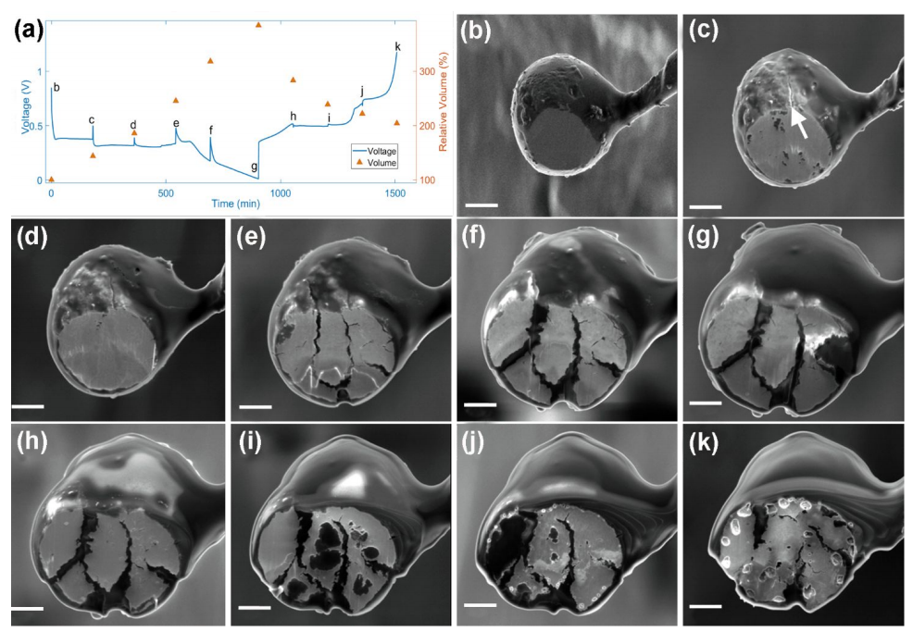

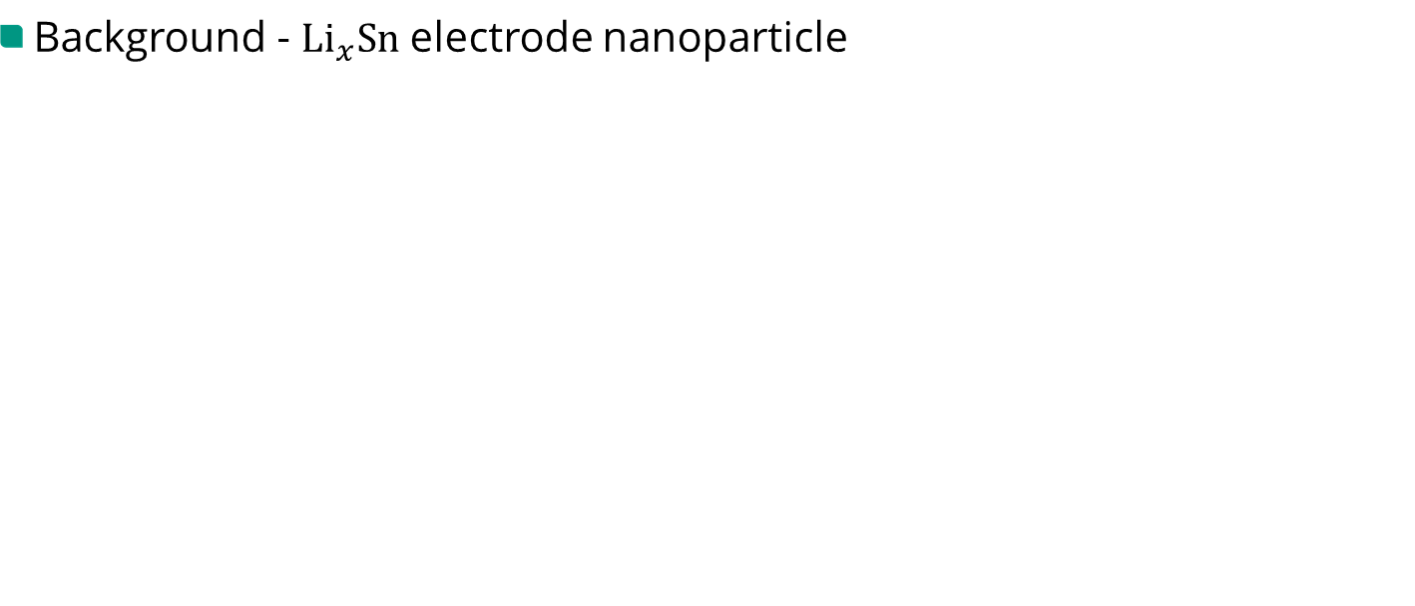
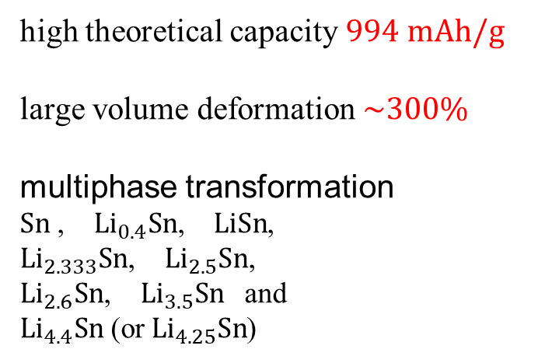
1. Previous work – ${Li}_{x}Sn$ nanoparticle
Background - ${Li}_{x}Sn$ electrode nanoparticle
high theoretical capacity $994 mAh/g$
large volume deformation $\sim 300\%$
multiphase transformation
$Sn$ , ${Li}_{0.4}Sn$, $LiSn$,
${Li}_{2.333}Sn$, ${Li}_{2.5}Sn$,
${Li}_{2.6}Sn$, ${Li}_{3.5}Sn$ and
${Li}_{4.4}Sn$ (or ${Li}_{4.25}Sn$)
Xinwei Zhou, ACS Applied Materials & Interfaces, 2019.

Slide 3
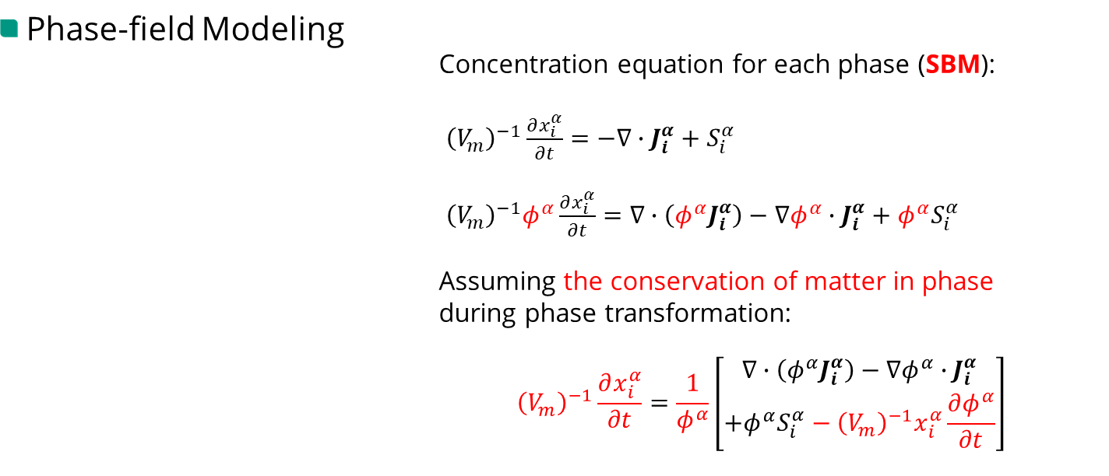
1. Previous work – ${Li}_{x}Sn$ nanoparticle
Phase-field Modeling
Concentration equation for each phase (SBM):
${\left(V_{m}\right)}^{−1}\frac{∂x_{i}^{α}}{∂t}=−∇∙J_{i}^{α}+S_{i}^{α}$
${\left(V_{m}\right)}^{−1}φ^{α}\frac{∂x_{i}^{α}}{∂t}=∇∙\left(φ^{α}J_{i}^{α}\right)−∇φ^{α}∙J_{i}^{α}+φ^{α}S_{i}^{α}$
Assuming the conservation of matter in phase
during phase transformation:
$${\left(V_{m}\right)}^{−1}\frac{∂x_{i}^{α}}{∂t}=\frac{1}{φ^{α}}\left[\begin{aligned}∇∙\left(φ^{α}J_{i}^{α}\right)−∇φ^{α}∙J_{i}^{α} \\ +φ^{α}S_{i}^{α}−{\left(V_{m}\right)}^{−1}x_{i}^{α}\frac{∂φ^{α}}{∂t}\end{aligned}\right]$$
Smoothed Boundary Method (SBM), Hui-Chia Yu, Modelling Simul. Mater. Sci. Eng, 2012

Slide 4
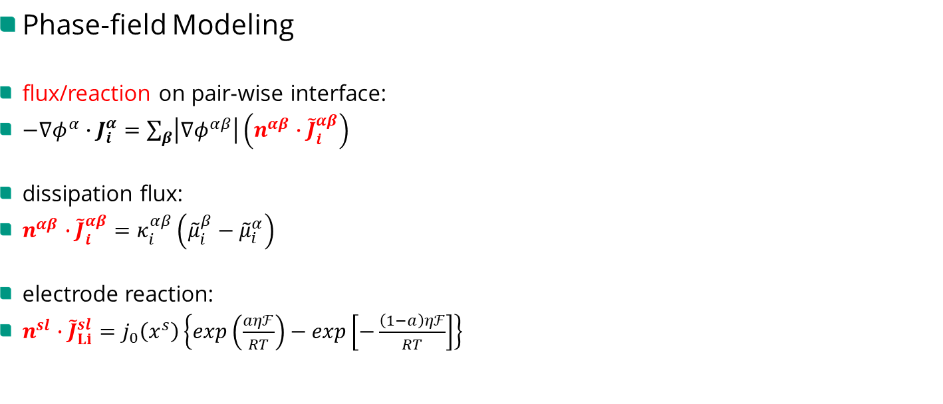
1. Previous work – ${Li}_{x}Sn$ nanoparticle
Phase-field Modeling
flux/reaction on pair-wise interface:
$−∇φ^{α}∙J_{i}^{α}=\sum_{β}{\left|∇φ^{αβ}\right|\left(n^{αβ}∙{\tilde{J}}_{i}^{αβ}\right)}$
dissipation flux:
$n^{αβ}∙{\tilde{J}}_{i}^{αβ}=κ_{i}^{αβ}\left({\tilde{μ}}_{i}^{β}−{\tilde{μ}}_{i}^{α}\right)$
electrode reaction:
$n^{sl}∙{\tilde{J}}_{Li}^{sl}=j_{0}\left(x^{s}\right)\left\{exp\left(\frac{aηℱ}{RT}\right)−exp\left[−\frac{\left(1−a\right)ηℱ}{RT}\right]\right\}$

Slide 5
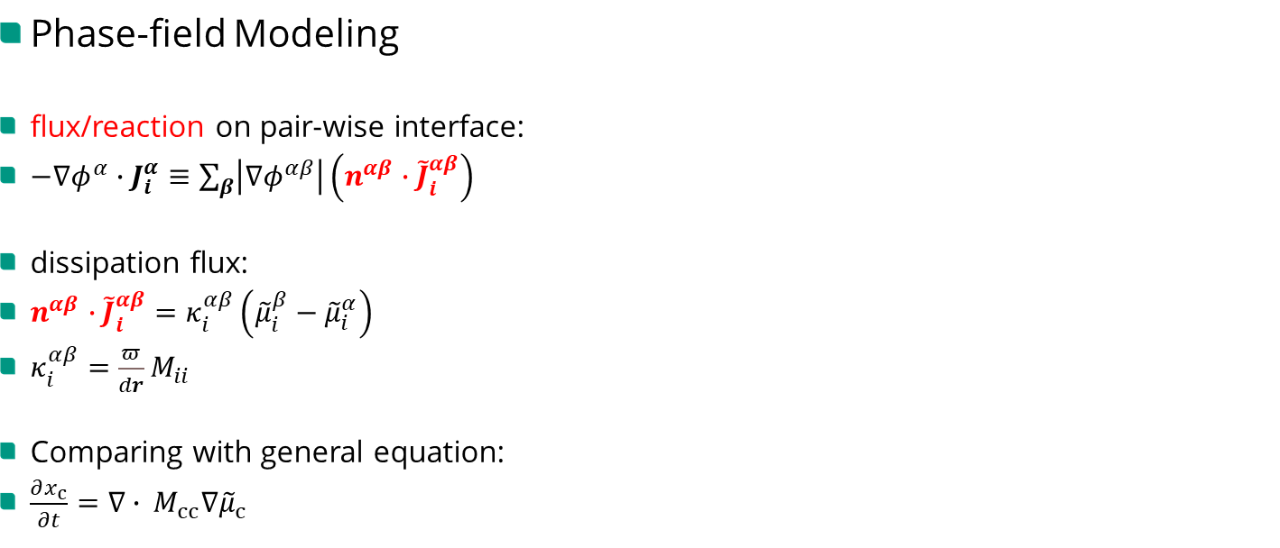
1. Previous work – ${Li}_{x}Sn$ nanoparticle
Phase-field Modeling
flux/reaction on pair-wise interface:
$−∇φ^{α}∙J_{i}^{α}≡\sum_{β}{\left|∇φ^{αβ}\right|\left(n^{αβ}∙{\tilde{J}}_{i}^{αβ}\right)}$
dissipation flux:
$n^{αβ}∙{\tilde{J}}_{i}^{αβ}=κ_{i}^{αβ}\left({\tilde{μ}}_{i}^{β}−{\tilde{μ}}_{i}^{α}\right)$
$κ_{i}^{αβ}=\frac{π}{dr}M_{ii}$
Comparing with general equation:
$\frac{∂x_{c}}{∂t}=∇∙{{}_{ }^{ }M}_{cc}∇{\tilde{μ}}_{c}$

Slide 6
1. Previous work – ${Li}_{x}Sn$ nanoparticle
Results
${Li}_{x}Sn$ nanoparticle, Q. Huang, CMS, 2023

Slide 7
1. Previous work – ${Li}_{x}Sn$ nanoparticle
Results
${Li}_{x}Sn$ nanoparticle, Q. Huang, CMS, 2023

Slide 8
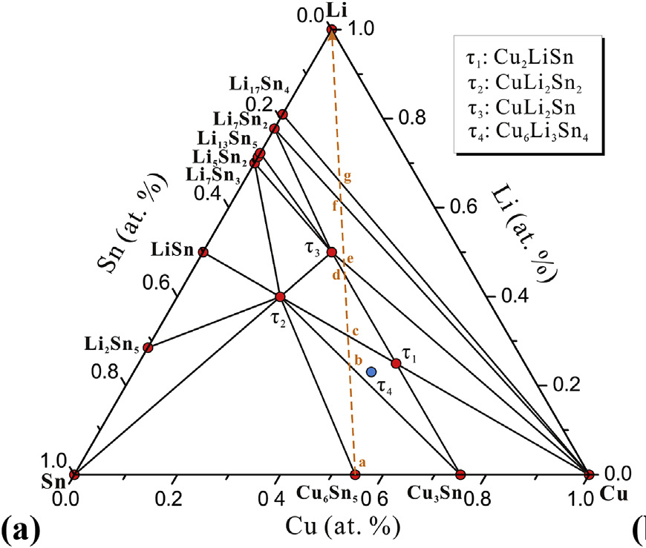


2. Current work – ${Cu}_{x}{Li}_{y}Sn$ nanoparticle
Phase-field Modeling of polycrystalline nanoparticle
Cu-Li-Sn system, Fan Zhang, Journal of Alloys and Compounds, 2019

Slide 9






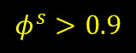
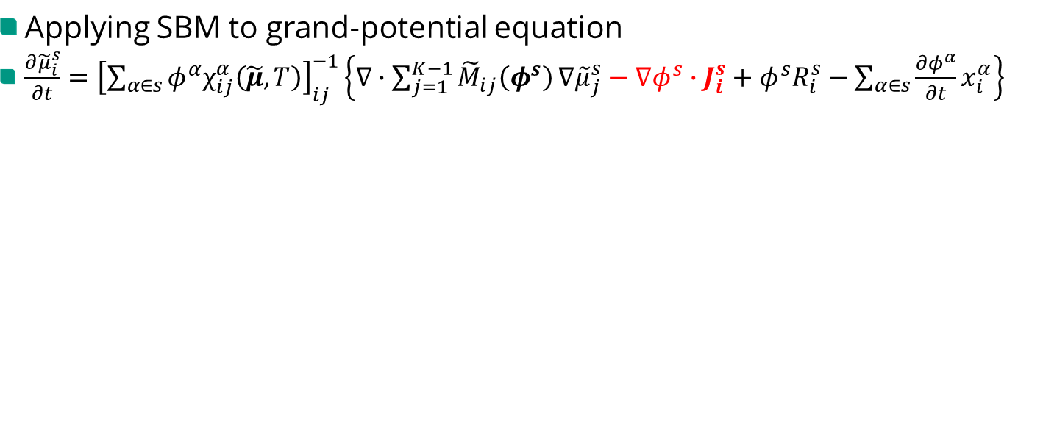
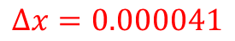
2. Current work – ${Cu}_{x}{Li}_{y}Sn$ nanoparticle
Applying SBM to grand-potential equation
$\frac{∂{\tilde{μ}}_{i}^{s}}{∂t}={\left[\sum_{α∈s}^{ }{φ^{α}χ_{ij}^{α}\left(\tilde{μ},T\right)}\right]}_{ij}^{−1}\left\{∇∙\sum_{j=1}^{K−1}{{\tilde{M}}_{ij}\left(φ^{s}\right)}∇{\tilde{μ}}_{j}^{s}−∇φ^{s}∙J_{i}^{s}+φ^{s}R_{i}^{s}−\sum_{α∈s}^{ }{\frac{∂φ^{α}}{∂t}x_{i}^{α}}\right\}$
(a)
(b)
(c)
$$φ^{s}>0.9$$
(d)
(e)
(f)
$$∆x=0.000041$$
Grand-potential equation, Abhik Choudhury, PHYSICAL REVIEW E, 2012

Slide 10






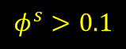
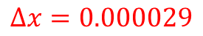
2. Current work – ${Cu}_{x}{Li}_{y}Sn$ nanoparticle
Applying SBM to grand-potential equation
$\frac{∂{\tilde{μ}}_{i}^{s}}{∂t}={\left[\sum_{α∈s}^{ }{φ^{α}χ_{ij}^{α}\left(\tilde{μ},T\right)}\right]}_{ij}^{−1}\left\{∇∙\sum_{j=1}^{K−1}{{\tilde{M}}_{ij}\left(φ^{s}\right)}∇{\tilde{μ}}_{j}^{s}−∇φ^{s}∙J_{i}^{s}+φ^{s}R_{i}^{s}−\sum_{α∈s}^{ }{\frac{∂φ^{α}}{∂t}x_{i}^{α}}\right\}$
(a)
(b)
(c)
$$∆x=0.000029$$
$$φ^{s}>0.1$$
(d)
(e)
(f)
Grand-potential equation, Abhik Choudhury, PHYSICAL REVIEW E, 2012

Slide 11


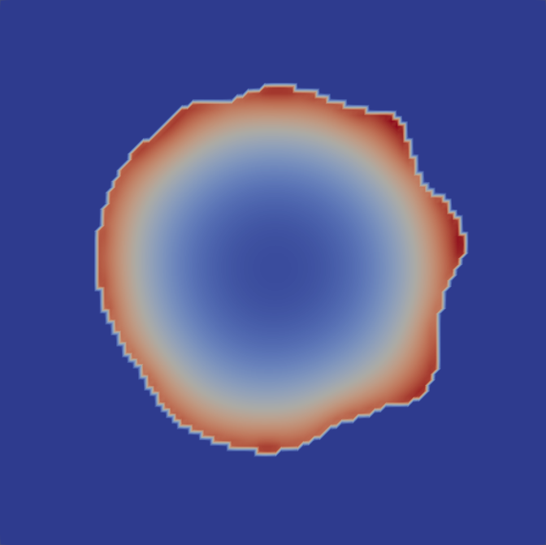



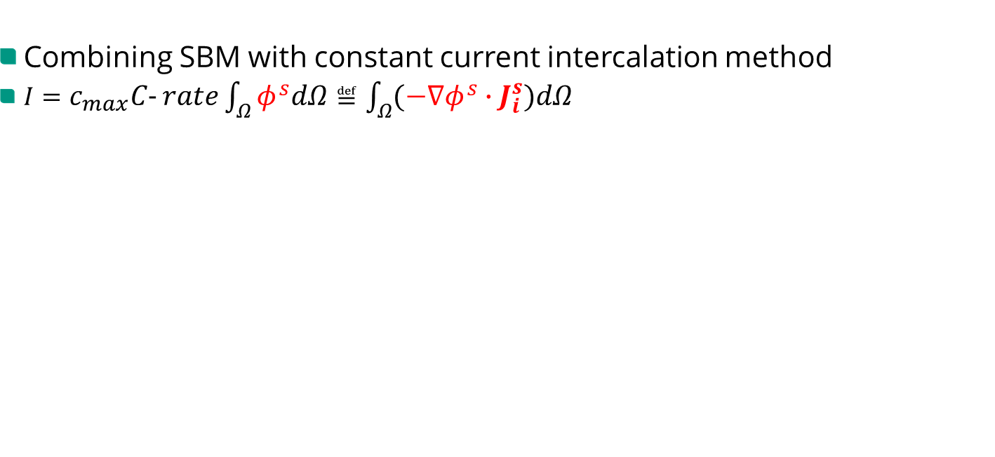
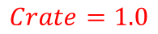
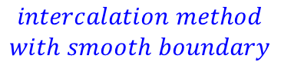
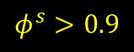
2. Current work – ${Cu}_{x}{Li}_{y}Sn$ nanoparticle
Combining SBM with constant current intercalation method
$I=c_{max}C‐rate\int_{Ω}^{ }{φ^{s}dΩ}≝\int_{Ω}^{ }{\left(−∇φ^{s}∙J_{i}^{s}\right)dΩ}$
(a1)
(a2)
(a3)
$$intercalation method$$
$$with smooth boundary$$
$$φ^{s}>0.9$$
$$Crate=1.0$$
(b1)
(b2)
(b3)
constant current intercalation method, Simon Daubner, Electrochimica Acta, 2022

Slide 12






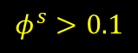
2. Current work – ${Cu}_{x}{Li}_{y}Sn$ nanoparticle
Combining SBM with constant current intercalation method
$I=c_{max}C‐rate\int_{Ω}^{ }{φ^{s}dΩ}≝\int_{Ω}^{ }{\left(−∇φ^{s}∙J_{i}^{s}\right)dΩ}$
(a1)
(a2)
(a3)
$$intercalation method$$
$$with smooth boundary$$
$$φ^{s}>0.1$$
$$Crate=1.0$$
(b1)
(b2)
(b3)
constant current intercalation method, Simon Daubner, Electrochimica Acta, 2022

Slide 13

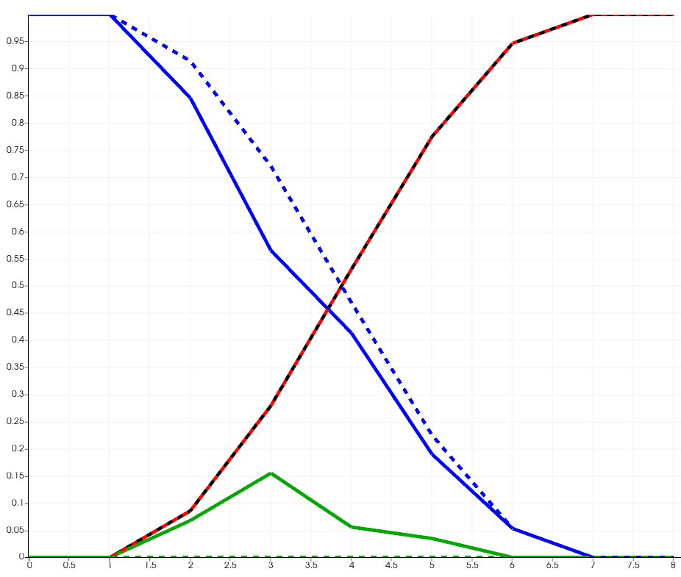
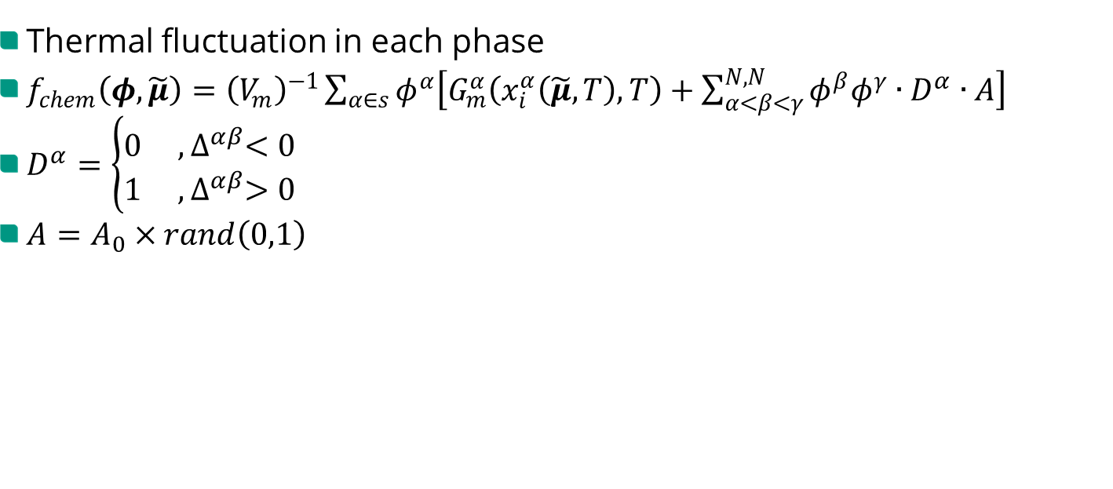
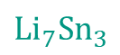
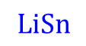
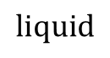
2. Current work – ${Cu}_{x}{Li}_{y}Sn$ nanoparticle
Thermal fluctuation in each phase
$f_{chem}\left(φ,\tilde{μ}\right)={\left(V_{m}\right)}^{−1}\sum_{α∈s}{φ^{α}\left[G_{m}^{α}\left(x_{i}^{α}\left(\tilde{μ},T\right),T\right)+\sum_{α<β<γ}^{N,N}{φ^{β}φ^{γ}∙D^{α}∙A}\right]}$
$D^{α}=\left\{\begin{matrix}0 , ∆^{αβ}<0 \\ 1 ,∆^{αβ}>0\end{matrix}\right.$
$A=A_{0}×rand\left(0,1\right)$
$$liquid$$
$$LiSn$$
$${Li}_{7}{Sn}_{3}$$
noise
thermal fluctuations, Ephraim Schoof, International Journal of Solids and Structures, 2018

Slide 14
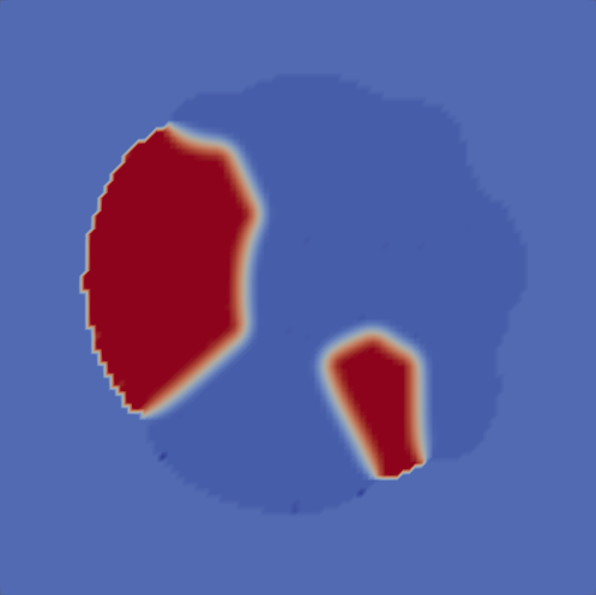
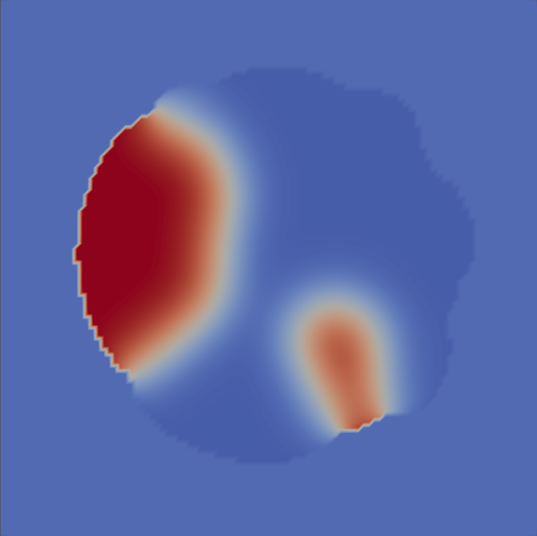
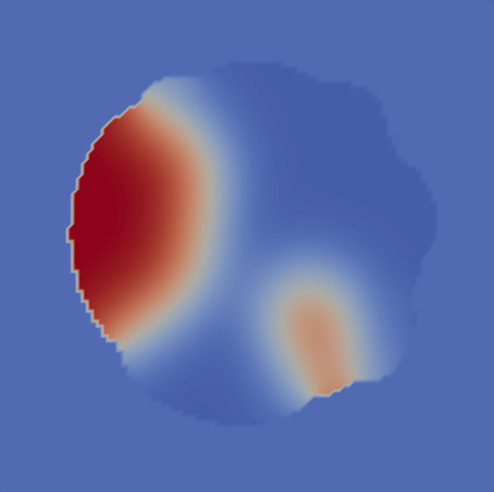
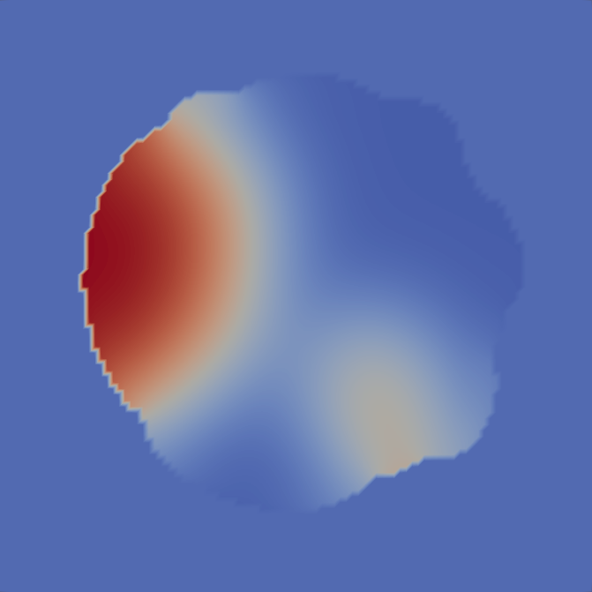






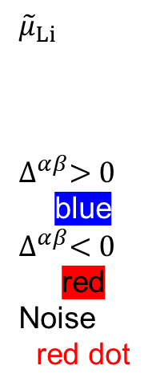

2. Current work – ${Cu}_{x}{Li}_{y}Sn$ nanoparticle
Thermal fluctuation in each phase
$f_{chem}\left(φ,\tilde{μ}\right)={\left(V_{m}\right)}^{−1}\sum_{α∈s}{φ^{α}\left[G_{m}^{α}\left(x_{i}^{α}\left(\tilde{μ},T\right),T\right)+\sum_{α<β<γ}^{N,N}{φ^{β}φ^{γ}∙D^{α}∙A}\right]}$
$${\tilde{μ}}_{Li}$$
$$∆^{αβ}>0$$
blue
$$∆^{αβ}<0$$
red
Noise
red dot
thermal fluctuations, Ephraim Schoof, International Journal of Solids and Structures, 2018

Slide 15





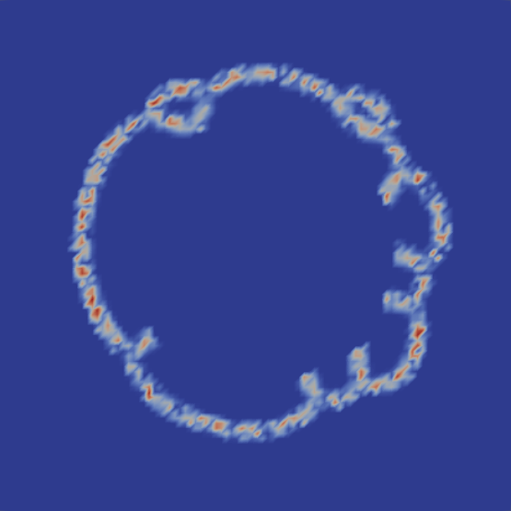


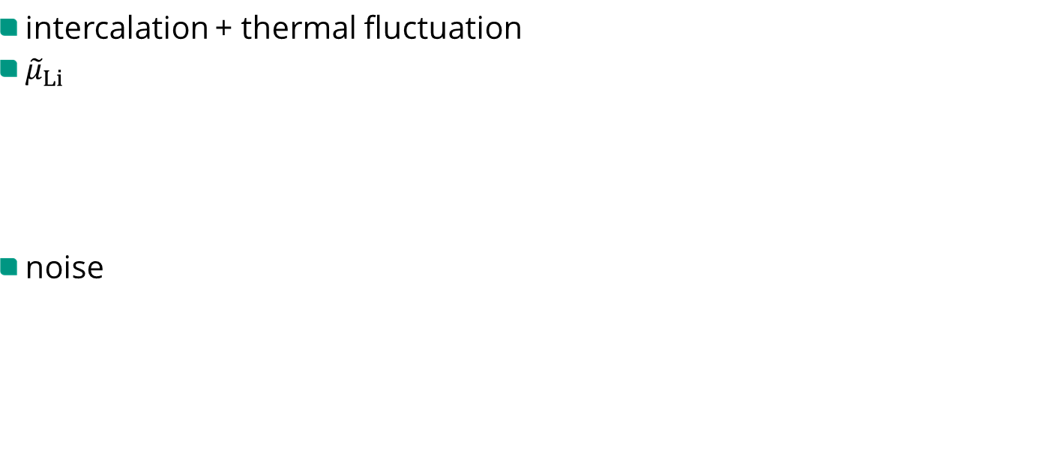
2. Current work – ${Cu}_{x}{Li}_{y}Sn$ nanoparticle
intercalation + thermal fluctuation
${\tilde{μ}}_{Li}$
noise

Slide 16








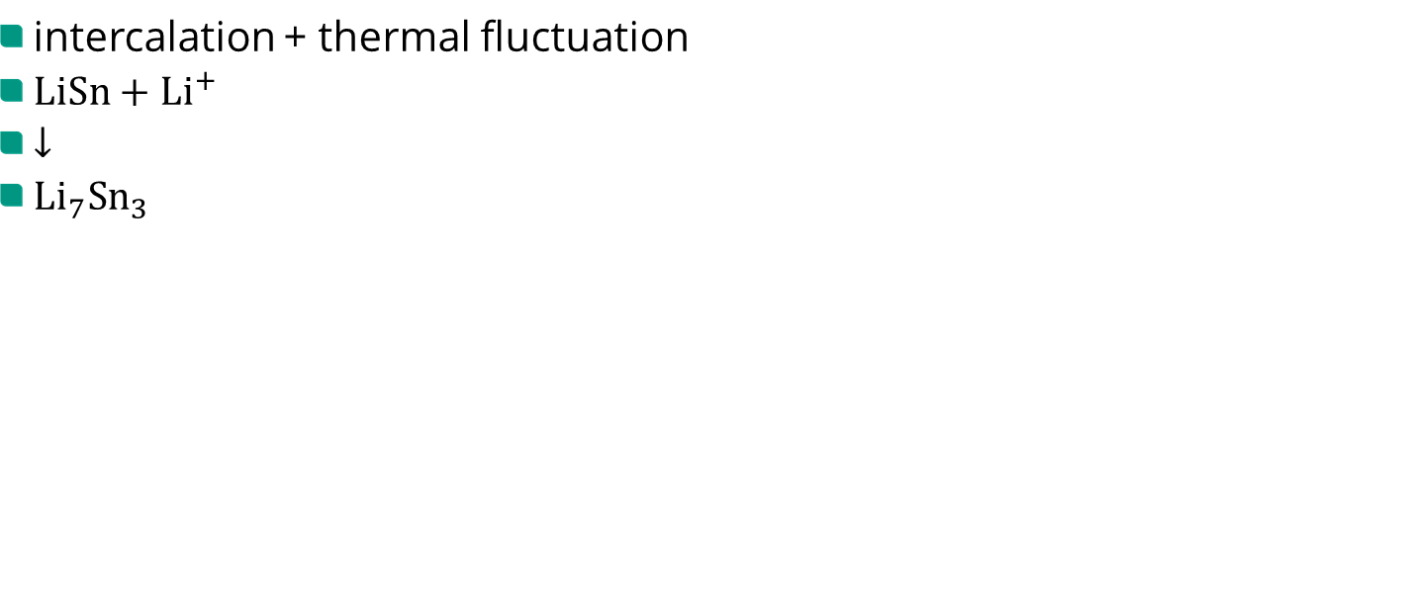
2. Current work – ${Cu}_{x}{Li}_{y}Sn$ nanoparticle
intercalation + thermal fluctuation
$LiSn+{Li}^{+}$
$↓$
${Li}_{7}{Sn}_{3}$

Slide 17

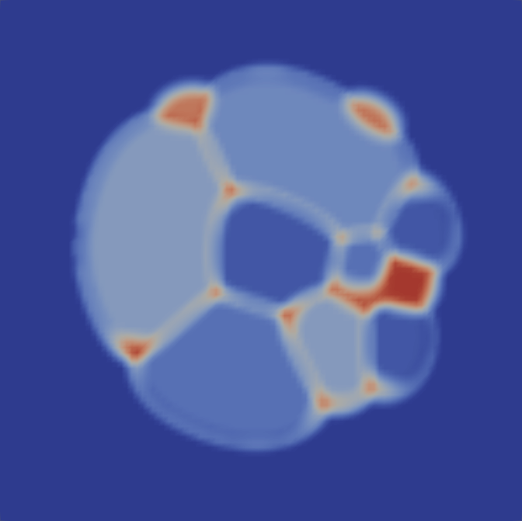









2. Current work – ${Cu}_{x}{Li}_{y}Sn$ nanoparticle
initialize a natural structure
Set $Cu:Li:Sn = 0.1:0.45:0.45$for $LiSn$ phase, add $Cu{Li}_{2}{Sn}_{2}$ noise

Slide 18






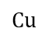
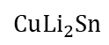
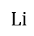
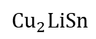
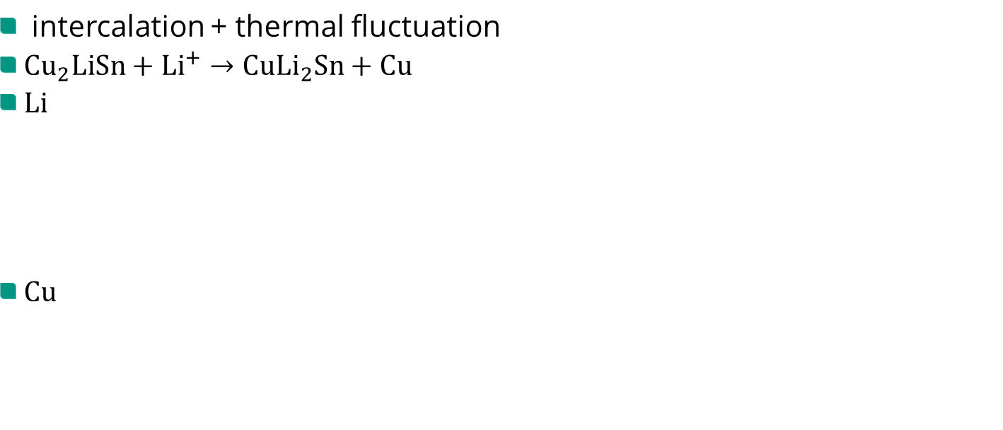
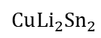
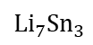
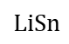
2. Current work – ${Cu}_{x}{Li}_{y}Sn$ nanoparticle
$$Li$$
intercalation + thermal fluctuation
${Cu}_{2}LiSn+{Li}^{+}→Cu{Li}_{2}Sn+Cu$
$Li$
$Cu$
$${Li}_{7}{Sn}_{3}$$
$$LiSn$$
$$Cu{Li}_{2}Sn$$
$$Cu{Li}_{2}{Sn}_{2}$$
$${Cu}_{2}LiSn$$
$$Cu$$

Slide 19
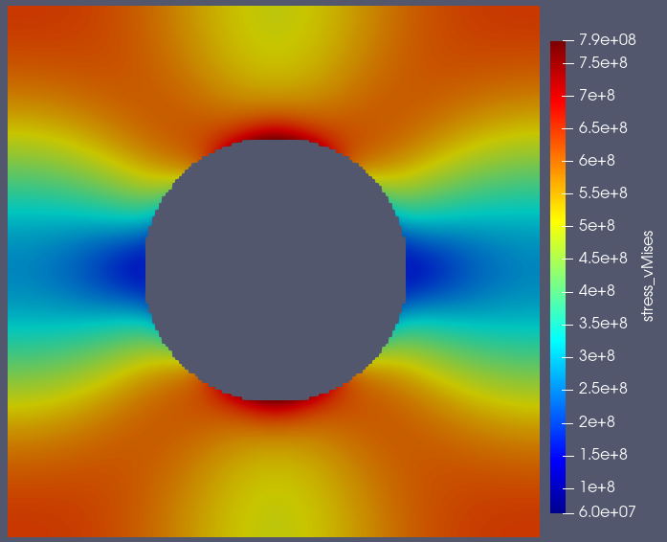
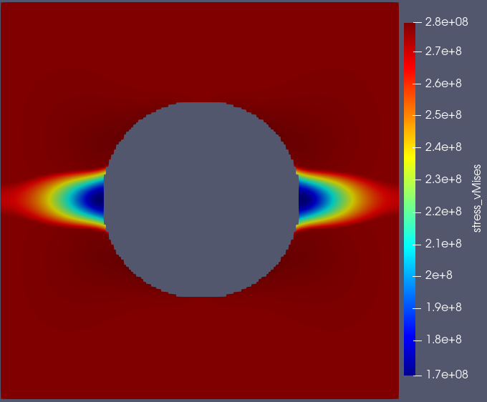
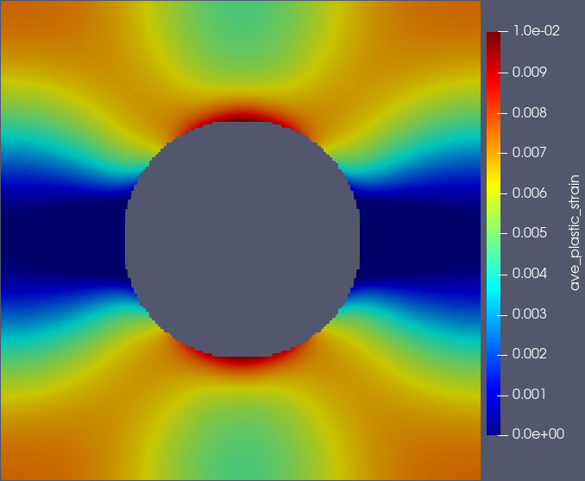
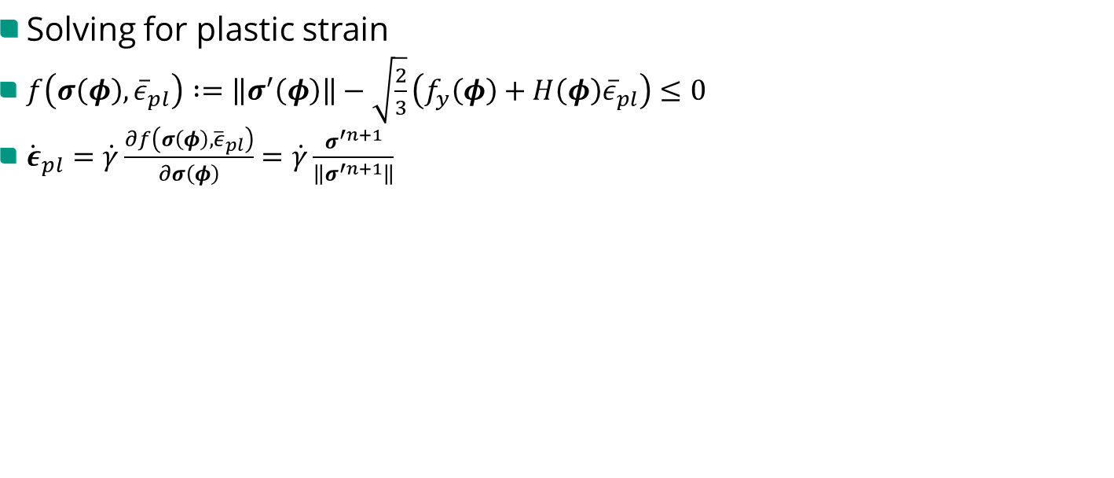
2. Current work – ${Cu}_{x}{Li}_{y}Sn$ nanoparticle
Solving for plastic strain
$f\left(σ\left(φ\right),{\overline{ε}}_{pl}\right)∶=\left\|σ^{′}\left(φ\right)\right\|−\sqrt{\frac{2}{3}}\left(f_{y}\left(φ\right)+H\left(φ\right){\overline{ε}}_{pl}\right)≤0$
${\dot{ε}}_{pl}=\dot{γ}\frac{∂f\left(σ\left(φ\right),{\overline{ε}}_{pl}\right)}{∂σ\left(φ\right)}=\dot{γ}\frac{σ^{′n+1}}{\left\|σ^{′n+1}\right\|}$
vMise stress
(pure elasticity)
vMise stress
(elasto-plasticity)
ave. plastic strain
(elasto-plasticity)
small strain elasto-plastic model, Daniel Schneider, Comput Mech, 2014

Slide 20



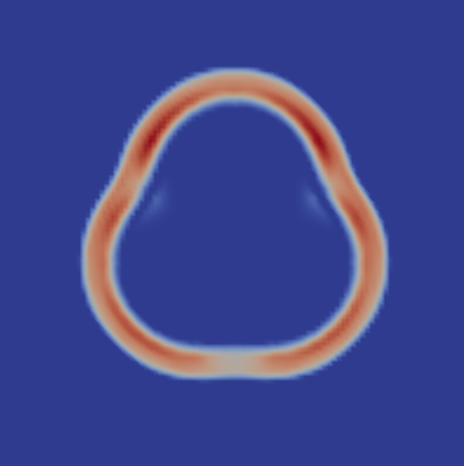
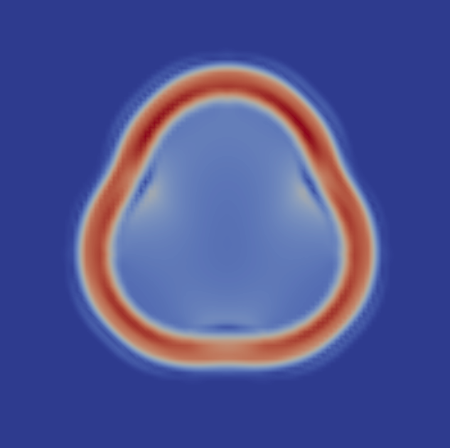
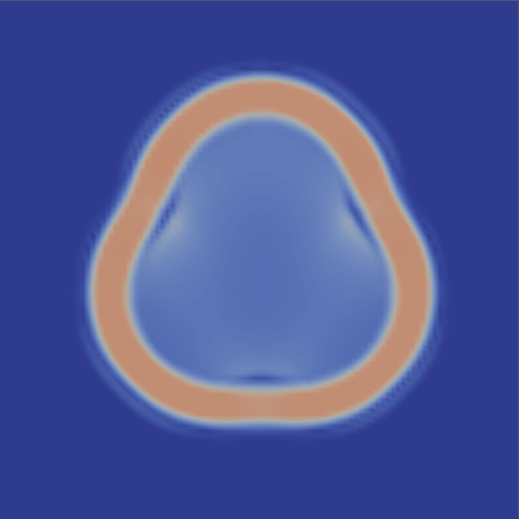


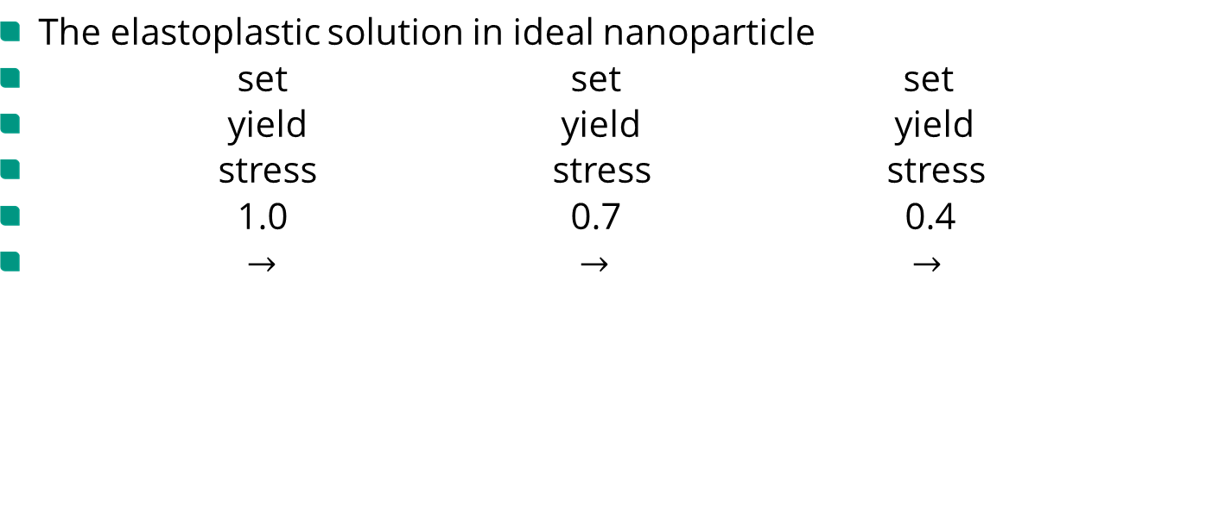
2. Current work – ${Cu}_{x}{Li}_{y}Sn$ nanoparticle
The elastoplastic solution in ideal nanoparticle
set set set
yield yield yield
stress stress stress
1.0 0.7 0.4
$→$ $→$ $→$
complex structure
ave-plastic strain
pure-elastic vMises stress
elastoplastic vMises stress

Slide 21



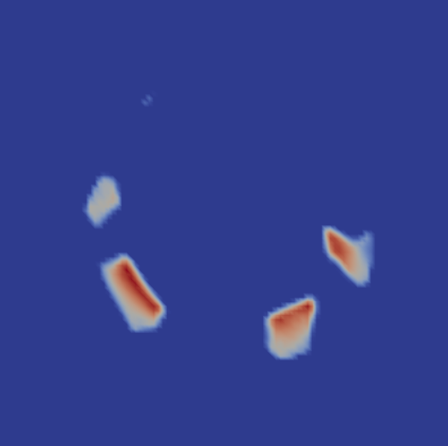

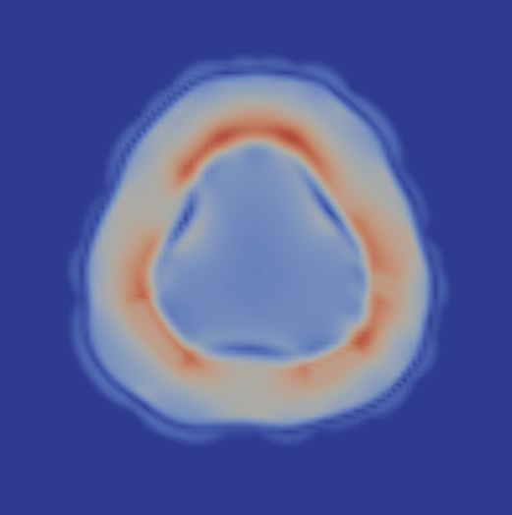



2. Current work – ${Cu}_{x}{Li}_{y}Sn$ nanoparticle
The elastoplastic solution in ${Cu}_{x}{Li}_{y}Sn$ nanoparticle
set set set
yield yield yield
stress stress stress
1.0 0.7 0.4
$→$ $→$ $→$
complex structure
ave-plastic strain
pure-elastic vMises stress
elastoplastic vMises stress

Slide 22

2. Current work – ${Cu}_{x}{Li}_{y}Sn$ nanoparticle
The elastoplastic solution in ${Cu}_{x}{Li}_{y}Sn$ nanoparticle
set set set
yield yield yield
stress stress stress
1.0 0.7 0.4
$→$ $→$ $→$
complex structure
ave-plastic strain
pure-elastic vMises stress
elastoplastic vMises stress

Slide 23


2. Current work – ${Cu}_{x}{Li}_{y}Sn$ nanoparticle
The elastoplastic solution in ${Cu}_{x}{Li}_{y}Sn$ nanoparticle
vMises
stress
pure elastic
yield stress = 1.0
yield stress = 0.7
yield stress = 0.4
yield stress = 0.1
complex structure
vMises stress

Slide 24


2. Current work – ${Cu}_{x}{Li}_{y}Sn$ nanoparticle
Crack propagation model
$F_{crack}=\int_{V}^{ }{\left\{G_{c}\left(φ\right)\left(ε_{c}{\left|∇φ_{c}\right|}^{2}+\frac{1}{4ε_{c}}φ_{c}^{2}\right)+W_{mech}+φ_{c}\sum_{α<β}^{N,N}{φ^{α}φ^{β}∙D_{c}∙A_{c}}\right\}dΩ}$
Crack profile in equilibrium:
$\frac{1}{2ε_{c}}φ_{c}=2ε_{c}\frac{∂^{2}φ_{c}}{∂x^{2}}, \int_{0}^{x}{\frac{∂φ_{c}}{∂x}\left(∙\right)dx}=\int_{0}^{x}{\frac{∂φ_{c}}{∂x}\left(∙\right)dx}$
$\frac{∂φ_{c}}{∂x}=±\frac{φ_{c}}{2ε_{c}}$
Crack resistance:
$\frac{G_{c}^{∗}}{2}=\int_{0}^{L}{G_{c}\left(ε_{c}{\left(\frac{∂φ_{c}}{∂x}\right)}^{2}+\frac{1}{4ε_{c}}φ_{c}^{2}\right)dx}$
$=\int_{0}^{1}{G_{c}\frac{2}{ε_{c}}\left(\frac{1}{4}φ_{c}^{2}\right)\frac{∂x}{∂φ_{c}}dφ_{c}}$
$=\int_{0}^{1}{G_{c}φ_{c}dφ_{c}}=\frac{G_{c}}{2}$
Phase-field modeling of ductile fracture, M. Ambati et al., Comput Mech, 2015

Slide 25
4. The End
Thanks for listening !

